Slide 1
Parallel Implementation of Connected Component Labelling Algorithm in NVIDIA® CUDA
Submitted by
SOUHAM BISWAS
B.Tech CSE VIIIth Sem.

Slide 2
Software Overview -
This software is basically an example to demonstrate the reduction in execution time which can be achieved by parallelizing traditional serial Connected Component Labelling Algorithms.
Connected-component labeling (alternatively connected-component analysis, blob extraction, region labeling, blob discovery, or region extraction) is an algorithmic application of graph theory, where subsets of connected components are uniquely labeled based on a given heuristic.

Slide 3
Application Features
Speed–
The software since it utilizes CUDA, will have a typical speedup of upto 3.2 when compared to a normal uniprocessor (SISD) system.
Scalable–
The application is scalable across all Windows® platforms which also have a CUDA enabled NVIDIA® GPU.
Wide Prominence-
Connected Component Labelling finds a lot of application in popular areas like medical image analysis, space image analysis etc. The modules developed as a part of this program may be directly deployed as a part of any application.

Slide 4
Software Pre-requisites -
NVIDIA® CUDA-Enabled Graphics Processing Unit (GPU)-
A CUDA enabled GPU is pre-requisite to run CUDA based applications which utilize the GPU as a GPGPU (General Purpose Graphics Processing Unit). A GPGPU is able to perform general computational tasks on the graphics hardware apart from graphics-related ones.
NVIDIA® CUDA Runtime-
A CUDA runtime is required for the CUDA APIs to interface with the GPU. It is also required by the CUDA-C compiler to map the C code to the instruction set of the GPU residing on the system.

Slide 5
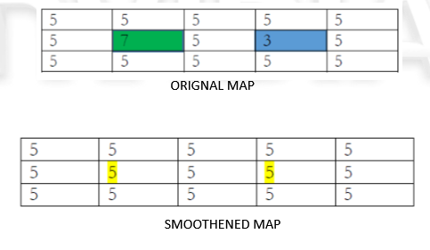
Software Workings-
Image Smoothening-
The input map is in greyscale which is smoothened out by processing the hills and dales in this step.

Slide 6
Thresholding-
Compute the average value of a given Map by computing the average of all cells. This is the "Threshold", T. The average will be the sum of all cell values divided by total number of cells, rounded down to the smaller integer.
For all cells in the map, assign labels as follows:
a) If (Cell Value < T) Cell Value = 0;
b) Else Cell Value = 1;

Slide 7
Connected Component Counting
Count the number of connected components in all binary Maps from the previous step.
The output will be the Map number followed by the corresponding number of connected components in that Map.
We will take 8-connected objects (meaning that diagonally adjacent 1s are considered connected).

Slide 8
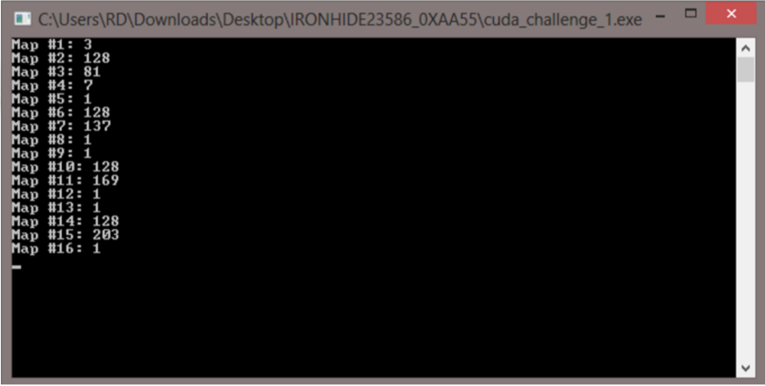
Output as <Map #>: <# of Connected Components>

Slide 9
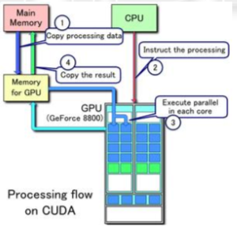
CUDA Processing Flow-
Object in front of Camera

Slide 10
Expansion Scope-
The software modules may be independently deployed as libraries in specialized applications
Also, cross-platform implementation of this application may be developed using OpenCL® so as to run the parallelized algorithms on GPUs manufactured by other companies like AMD, Intel etc.

Slide 11
Development Softwares Used -
Visual Studio 2012-
Visual Studio Software is a comprehensive software development IDE from Microsoft which allows for software development for any windows based platform in various languages.
This software in conjunction with the CUDA toolkit for Visual Studio was used to develop the software.

Slide 12
CUDA Libraries-
These libraries implement various GPU hardware level functionalities in the form of special directives. Functionalites include thread synchronization, management of deveice and host memory and other crucial ones for which a software implementation would either be impossible or too computationally complex.

Slide 13
Bibliography
www.stackoverflow.com
www.codeproject.com
www.dreamincode.com
www.msdn.microsoft.com

